Slide 1
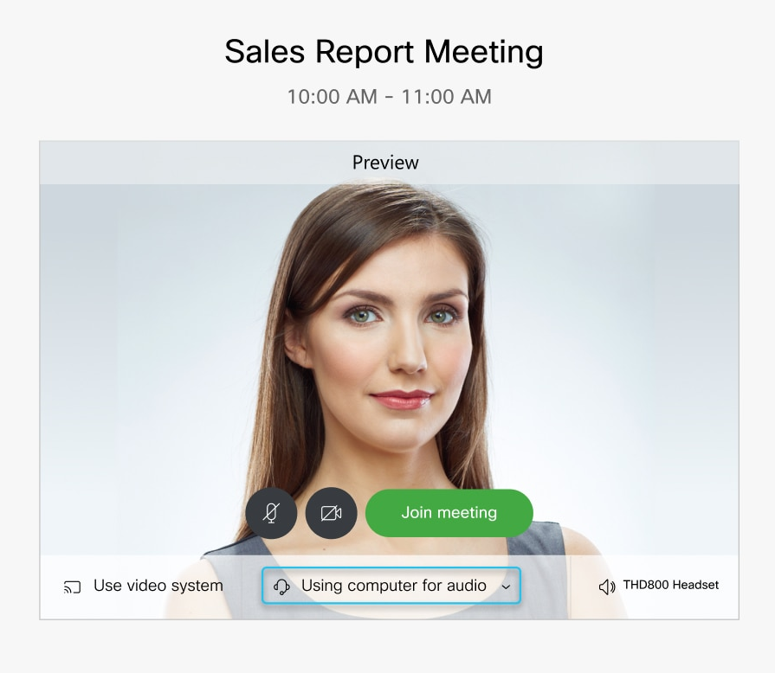
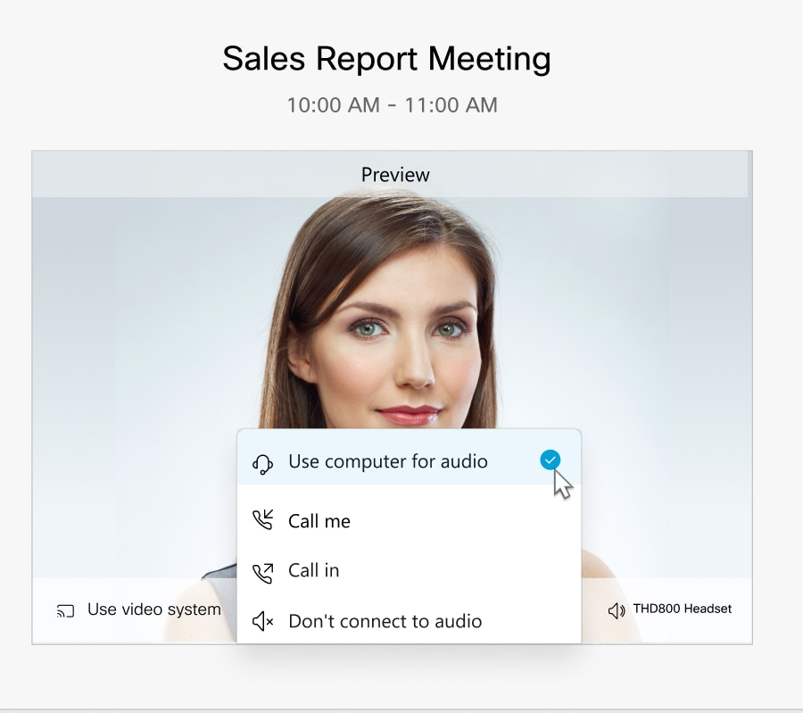
Welcome and thank you for joining us for today's presentation. Our topic is “Employer Practices to Combat COVID-19.”
We recommend selecting “Use computer for audio,” which will allow the presentation to be heard through your computer via the speakers or a headset. This is the default audio connection type. Visit help.webex.com for help in connection to a WebEx Event.

Slide 2

SARS-CoV-2 ►COVID-19

Slide 3
Employer Practices to Combat Covid-19
Presenters:
Patti Ramseur
Beau Howard
Moderator:
Jesse Elison

Slide 4
Unemployment Compensation Benefits
State Specific Laws & Processes
Georgia
    Emergency Order requires employer to file Partial Unemployment Insurance claim for any employee who suffers reduced hours because of COVID-19
    Partial UI claims must be filed online
    Partial UI claims can be mass uploaded in a spreadsheet
    Earnings threshold raised from $50/week to $300/week
    Max benefit is $965 ($365 Georgia UI + $600 Federal CARES Act)
    Minimum benefit is $601 ($1 Georgia UI + $600 Federal CARES Act)
    Benefits are determined weekly, which means: (a) partial furloughs possible; and (b) have to file every week
North Carolina

Slide 5
FFCRA - Enhanced Unemployment Compensation Benefits
Based on
    Waiting period waiver
    Work search requirement waiver for employees directly impacted by COVID-19 on account of an illness in the workplace or direction from a public health official to isolate or self-quarantine
    No charge to most employer accounts for these COVID-19 related benefits
      Self-insured employers still charged
(CARES Act changes unemployment)

Slide 6
Unemployment Compensation Benefit Eligibility
Any Loss of Income
  Reduced hours (most states)
  Salary reduction (most states)
  Furlough
  Permanent Layoff

Slide 7
Furlough
Eligible for unemployment compensation
Maintain attachment to employer
  Easier to start up once “all clear” sounded
Eligible for FFCRA benefits (maybe)
No requirement to pay out accrued pay (most states)
Potential lose of health benefits
  Trigger COBRA
No WARN exposure if less than 6 months
  Beware of state mini-WARN Acts

Slide 8
Permanent Layoffs
Eligible for unemployment compensation
Not eligible for FFCRA benefits
Requirement to pay out accrued pay
Lose eligibility for health benefits
  Trigger COBRA
WARN Act notice may be necessary but unforeseen business circumstances may apply

Slide 9
Families First Coronavirus Response Act (FFCRA)
Emergency Paid Sick Leave Act (EPSLA)
Emergency Family and Medical Leave Expansion Act (EFMLEA)

Slide 10
FFCRA
Which employers are required to provide paid sick and family leave?
  Private employers with fewer than 500 employees (including not for profit employers) and governmental employers (regardless of the number of employees)
  NOTE: this includes employers who are otherwise exempt from the FMLA who have fewer than 50 employees
Are certain employees exempt?
  The benefits do not apply to certain federal government employees. Employers also may exclude employees who are health care providers and emergency responders.

Slide 11
Events that trigger Paid Sick Leave for employees
Unable to work or telework because Employee:
1. Subject to a federal, state, or local quarantine or isolation related to Covid-19
2. Advised by HCP to self-quarantine due to concerns related to Covid-19
3. Experiencing symptoms of Covid-19 and seeking medical diagnosis
4. Caring for an individual who is subject to (1) or (2)
5. Caring for his/her child because school or place of care is closed or child care provider of child is unable to care due to COVID-19 precautions
6. Experiencing any other substantially similar condition specified by Secretary of Health & Human Services

Slide 12
Events that trigger Extended Family Leave for employees
Only One Reason:
#5 -- Caring for employee’s child whose school or childcare provider is closed or unavailable for COVID-19 reasons.

Slide 13
What Type of Paid Sick Leave is Available (EPSLA)?
Generally:
Two weeks (up to 80 hours) of paid sick time at the regular rate of pay for reasons #1-3
OR
Two weeks (up to 80 hours) of paid sick time at two-thirds the regular rate of pay for reasons # 4-5

Slide 14
What Type of Paid Family Leave is Available (EFMLEA)?
Up to an additional 10 weeks of paid family leave at two-thirds the regular rate of pay for reason #5
  where EE has been employed for at least 30 calendar days and is unable to work due to a bona fide need for leave to care EE’s child, whose school or child care provider is closed or unavailable for reasons related to COVID-19

Slide 15
Duration of Leave
For how long can an employee take paid sick leave?
For reasons #1-4 – a F/T EE is eligible for 80 hours of leave
  P/T EE is eligible for the number of hours of leave that the EE works on average over a two-week period
For how long can an employee take paid family leave?
For reason #5 – a F/T EE is eligible for up to 12 weeks of leave (two weeks of paid sick leave followed by up to 10 weeks of paid expanded family and medical leave) at 40 hours a week
  P/T EE is eligible for leave for the number of hours that the employee is normally scheduled to work over that period.

Slide 16
Amount of Leave Pay an Employee Can Receive
There are daily and aggregate caps.
For leave for reasons # 1-3
  sick leave pay is at the regular rate or the applicable minimum wage, whichever is higher
  up to $511 per day and $5,110 in the aggregate (over a 2-week period).
For leave for reason # 4
  sick leave pay is at 2/3 the regular rate or 2/3 the applicable minimum wage, whichever is higher
  up to $200 per day and $2,000 in the aggregate (over a 2-week period).
For leave for reason #5
  leave pay is at 2/3 the regular rate or 2/3 the applicable minimum wage, whichever is higher
  up to $200 per day and $12,000 in the aggregate (over a 12-week period).

Slide 17
Coronavirus Aid, Relief, and Economic Security (CARES) Act
Modifies the Families First Coronavirus Response Act (FFCRA)
Adds additional $600 weekly UI benefit, available if employee is eligible for at least $1 of state UI benefits
Requires employer for file partial UI claim
Removes job search requirement from UI eligibility
Benefits paid for partial UI claims based on COVID-19 not charged to employer’s account
$2.2 Trillion
Smaller employers (<500 employees) eligible for loans up to $10MM

Slide 18
Other Employer Considerations
Can an employee take other paid leave instead on these new types of leave?
An employee may elect to substitute any accrued vacation leave, personal leave, or medical or sick leave, as well as sick or family leave mandated by state and local governments
  ER cannot require
Is there an exemption for small businesses?
Employers with fewer than 50 employees may qualify for exemption if the leave requirements would jeopardize the viability of the business as a going concern
  USDOL is expected to publish regulations about this exemption in the future

Slide 19
How FFCRA leave interacts with existing FMLA laws
Coverage
12 weeks total
Conditions otherwise covered by FMLA

Slide 20
Employer Tax Credit
Can an employer receive reimbursement for payment of FFCRA paid leaves?
Yes, 100% is refundable as a tax credit with reimbursement as a credit against Social Security and Medicare payroll taxes. The U.S. Treasury may develop a mechanism for more accelerated reimbursement to small businesses.

Slide 21
Required Notice of Rights
Employers must conspicuously post a notice of employee rights in a form to be prepared by DOL
Employers may not discriminate or retaliate against employees who use paid sick time or paid family leave, or who engage in other protected activity
Remedies
  For failure to provide paid sick time, FLSA remedies apply
  For failure to provide paid family leave, FMLA remedies apply

Slide 22
Best Practices for dealing with employees affected by COVID-19
EEOC/ADA Guidance
Medical Inquiries
ADA accommodations
HIPPA concerns
CDC/OSHA Workplace Guidance

Slide 23
EEOC/ADA Guidance
  ADA and Rehabilitation Act continue to apply but do NOT prevent employers from following (evolving) CDC Guidelines
  2. EEOC Guidance “Pandemic Preparedness in the Workplace and the Americans with Disability Act” (originally issued in 2009 during H1N1 virus; revised March 21, 2020)

Slide 24
EEOC/ADA Guidance
  3. “Direct Threat Standard”: Employer may,
  Screen applicants for symptoms of COVID-19
  Take an applicant’s temperature post-offer/pre-employment medical exam
  Delay the start date for one who has COVID-19 or symptoms
  Withdraw an offer if immediate start is required for one who has COVID-19 or symptoms
  Require a doctor’s note to return to work

Slide 25
Record Keeping
OSHA Recording Cases of COVID-19
300 Log
HIPAA Medical records/tests
Confidentiality; separate record keeping

Slide 26
CDC Guidance
CDC Guidance in the Workplace
Interim Guidance for Businesses and employers
Cleaning and Disinfection
OSHA Guidance on Preparing Workplaces for COVID-19

Slide 27
OSHA Guidance
General Duty Clause (29 USC 654(a)(1))
Employer to furnish “… a place of employment… free from recognized hazards that are causing or are likely to cause death or serious physical harm
Classifying workers’ risk
Current PPE standards

Slide 28
OSHA Guidance
Develop an Infectious Disease Preparedness and Response Plan
Where workers might be exposed (including non-work factors)
Workers’ individual risk factors
Controls (air filters, PPE supplies, hygiene practices, cleaning, communication)
Policies (e.g. prompt identification and isolation of sick people)

Slide 29
Critical Infrastructure /Essential Activities
CDC Safety Practices for Critical Infrastructure (CISA List of 16 different sectors, including Transportation)
Pre-Screen: measure temperature
Regular Monitoring
Wear a Mask: for 14 days since last exposure
Social Distancing: Maintain 6 feet
Disinfect and Clean Work Spaces

Slide 30

Quarantine Orders Federal/State/Local: Locations; Penalties; Dates (extensions)

Slide 31
Where Can We Get Additional Information?
Resources:
  Fox Rothschild - https://www.foxrothschild.com/coronavirus-resources/
  U.S. DOL - https://www.dol.gov/agencies/whd/pandemic
  OSHA coronavirus guidance: www.osha.gov/SLTC/covid-19/
  EEOC Guidance https://www.eeoc.gov/eeoc/newsroom/wysk/wysk_ada_rehabilitaion_act_coronavirus.cfm
  CDC https://www.cdc.gov/coronavirus/2019-ncov/community/organizations/businesses-employers.html
Notes:
Centers for Disease Control and Prevention
World Health Organization
Questions – Okay to drink Corona beer?

Slide 32
Please note that this presentation and all of the accompanying materials are protected by copyright, and that the entire presentation is being recorded. Also, please note the material presented by our speakers has been gathered for general informational purposes only.
No information presented in this presentation constitutes legal advice nor is it intended to be fact-specific. As there may be occasions where Fox Rothschild represents clients who may be adverse to your interests, discussion at this program cannot touch upon any fact-specific matters. Attendees should consult with knowledgeable legal counsel to determine how applicable laws pertain to specific facts and situations.
These materials are based on the most current information available. Since it is possible laws or other circumstances may have changed since this presentation, please consult with legal counsel to discuss any action you may be considering as a result of attending this program or reading these materials.
Attendance at this program and/or receipt of these materials is not intended to create, nor does it establish, an attorney-client relationship.

Slide 33
Patti Ramseur
336-378-5304 pramseur@foxrothschild.com
Beau Howard
404-870-3763 fbhoward@foxrothschild.com
Jesse Elison
404-962-1024 jelison@foxrothschild.com

